Slide 1

Sound ClassIfıcatıon wth UrbanSound8K
Tuna Kutoğlu

Slide 2

Table of Contents
Project Overview
Dataset Details
MFCC(Mel-Frequency Cepstral Coefficients)
Classification Models
Logistic Regression
Random Forest
Results and Insights
What is MFCC
Feature Extraction with MFCC
Coefficients
Examples
Libraries Used in the Code

Slide 3

Project Overview
This study focuses on the challenge of sound classification. The objective is to extract meaningful features from various audio files and achieve accurate classification using machine learning techniques. To accomplish this, two distinct models have been employed: Logistic Regression and Random Forest.

Slide 4
Dataset Details
In this project, a reduced version of the UrbanSound8K dataset has been used for sound classification. UrbanSound8K is a comprehensive dataset consisting of 8,732 audio files containing various environmental sounds. However, to shorten processing time and enable faster prototyping, only a specific subset of the dataset was selected.
Classes
Air Conditioner
Car Horn
Children Playing
Dog Bark
Drilling
Gun Shot
Jackhammer
Siren
Engine Idling
Street Music
Data Split
The training and test data have been split, with 80% of the dataset used for training and 20% used for testing.

Slide 5

MFCC(Mel-Frequency Cepstral Coefficients)
What is MFCC
MFCC (Mel-Frequency Cepstral Coefficients) is a technique that represents the frequency characteristics of audio signals. In our project, we extracted MFCCs from the audio files in the UrbanSound8K dataset, obtaining numerical data that better represents the essential features of the sound. These features helped the sound classification model deliver more accurate results.

Slide 6
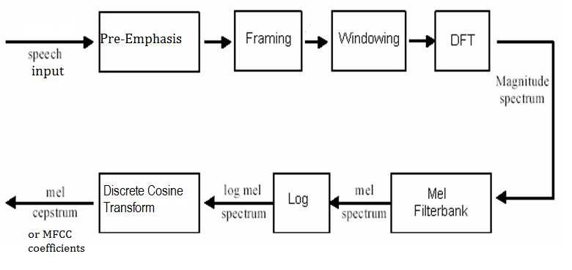
Feature Extraction with MFCC
MFCC Extraction Steps:
Framing:
The audio signal is divided into small time frames (e.g., 25 ms segments). This step allows the signal to be analyzed in manageable portions.
Windowing:
A window function (typically a Hamming window) is applied to each frame. This reduces discontinuities between frames and minimizes spectral leakage.
Fast Fourier Transform (FFT):
The frequency components of each frame are extracted using FFT, transforming the signal from the time domain to the frequency domain.
Mel Frequency Scaling:
The frequency components are converted to the Mel scale, which reflects the human ear's sensitivity to different frequencies.
This is achieved using Mel filter banks, which are densely packed at low frequencies and sparse at high frequencies.
Logarithmic Energy:
The logarithm of the energy values in the Mel scale is computed. This step models the logarithmic perception of loudness by the human ear.
Discrete Cosine Transform (DCT):
Finally, DCT is applied to the logarithmic energy values.
DCT compresses the information into a low-dimensional representation, producing the Mel-Frequency Cepstral Coefficients (MFCCs).
Typically, only the first 12-13 coefficients are retained, as they capture the most relevant features of the signal.

Slide 7
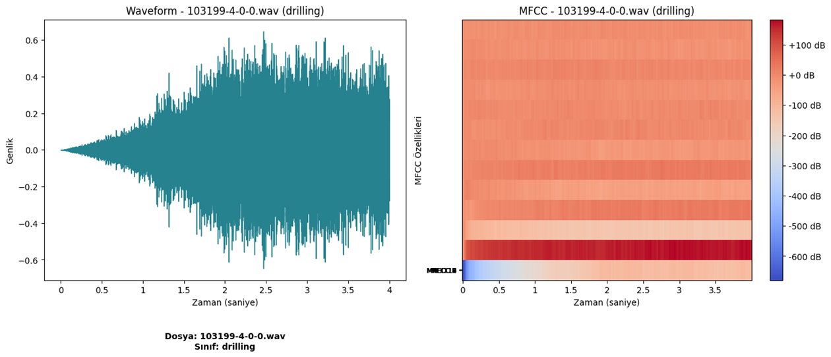
MFCc COEFFICIENTS
MFCC coefficients represent the spectral features of an audio signal. Each coefficient captures a different aspect of the signal's frequency content, with:
First few coefficients: Represent the overall shape of the spectrum (broad frequency characteristics).
Higher coefficients: Capture finer details, such as harmonic patterns or temporal variations.
They provide a compressed representation of the sound, emphasizing perceptually relevant frequencies.

Slide 8
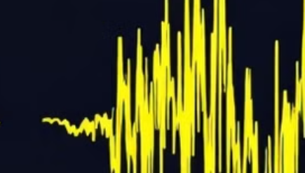
examples
[[-272.0238342285156, 50.64923858642578, -19.704614639282227, 38.279178619384766, -1.86197829246521, 12.339811325073242, 0.849643886089325, 5.812249183654785, 2.5370960235595703, -0.8827674388885498, 7.889730453491211, -0.9849236011505127, 6.084908485412598], [-297.2771911621094, 61.40046310424805, -18.246475219726562, 32.24281311035156, 0.5935836434364319, 18.792604446411133, 1.7394115924835205, 5.266286373138428, 2.8680145740509033, -2.4170539379119873, 4.377298355102539, 2.8540871143341064, 4.250560283660889],

Slide 9
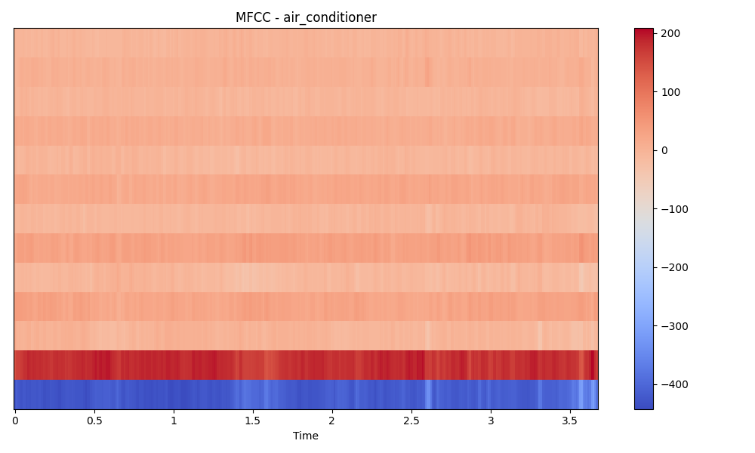
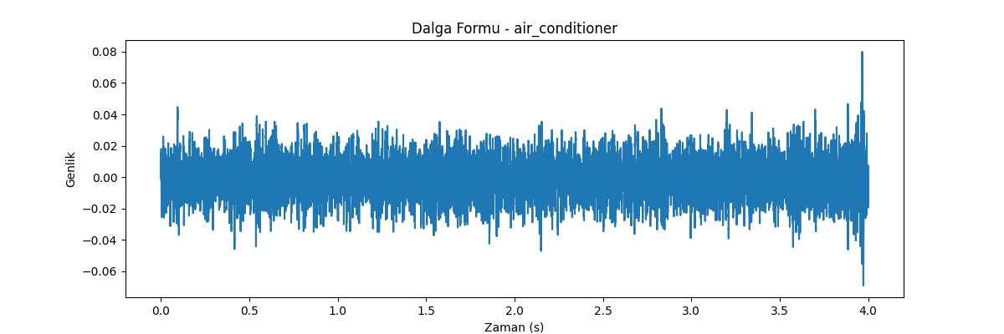

Air conditoner EXAMPLE

Slide 10
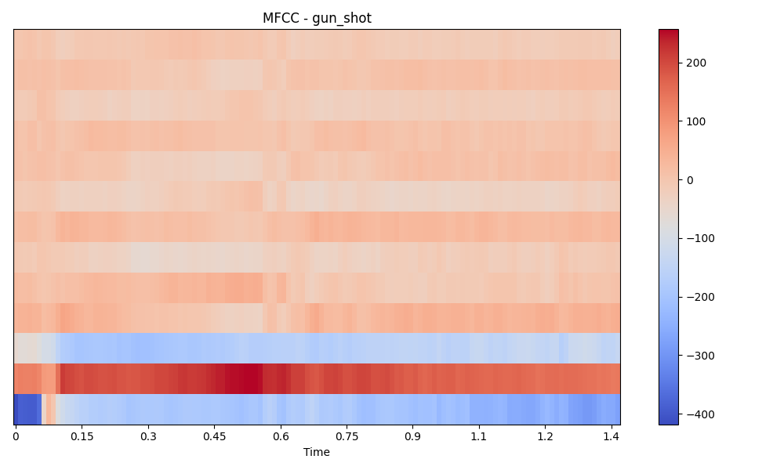
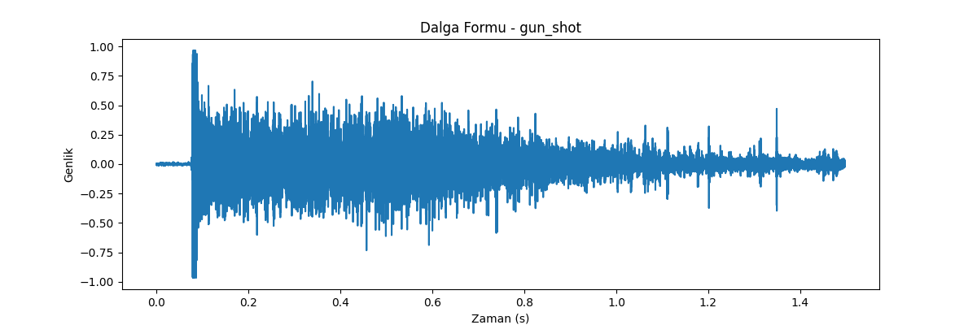
GUN SHOT EXAMPLE

Slide 11
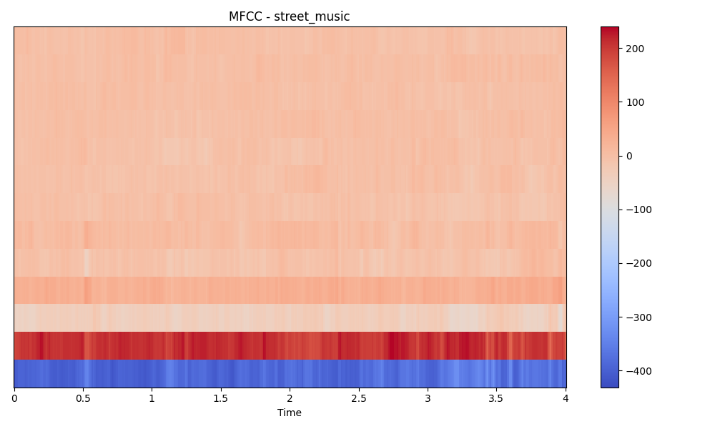
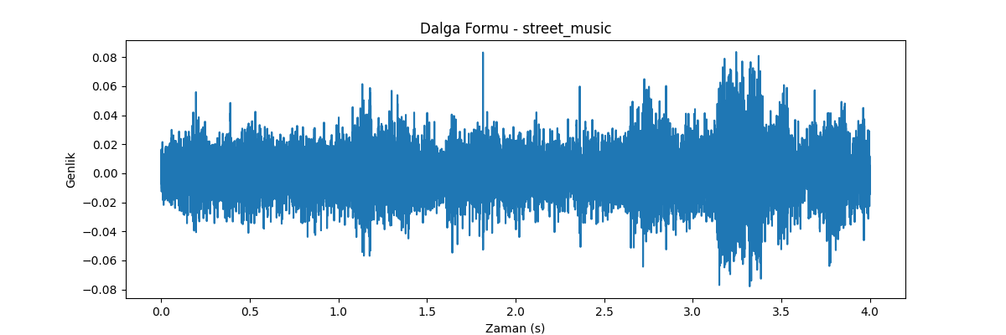
STREET MUSıC EXAMPLE

Slide 12
Classification Models
Model 1: Logistic Regression Logistic Regression estimates probabilities for each class and selects the class with the highest probabilities.
Model 2: Random Forest Random Forest combines multiple decision trees to produce shapes. The outcome of each decision tree is determined by voting.

Slide 13
Logistic Regression: Technical Overview
Type: Linear model for binary/multiclass classification.
Advantages:
Simple and interpretable.
Effective for linearly separable data.
Drawback: Limited performance with non-linear relationships.

Slide 14

Random Forest: Technical Overview
Type: Ensemble learning method using decision trees.
Process:
Bootstrap sampling for multiple training subsets.
Train decision trees independently.
Aggregate predictions (majority vote or average).
Advantages:
Handles non-linear data.
Reduces overfitting by averaging.
Drawback: Computationally intensive for large datasets.

Slide 15

Results and Insights

Slide 16
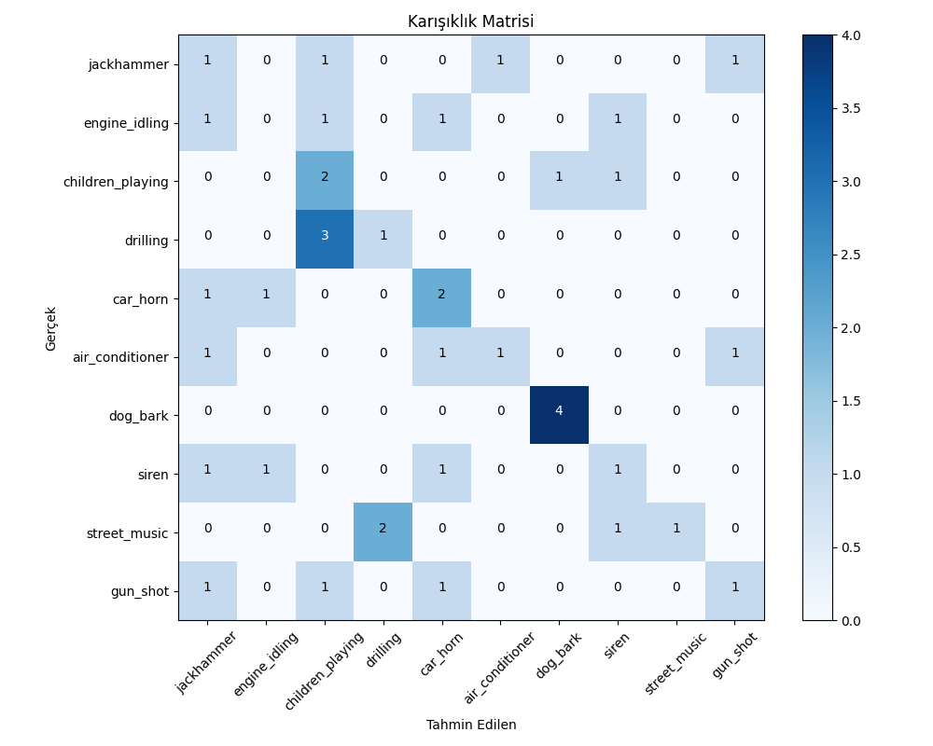
Model 1: Logistic Regression
Accuracy 35%

Slide 17
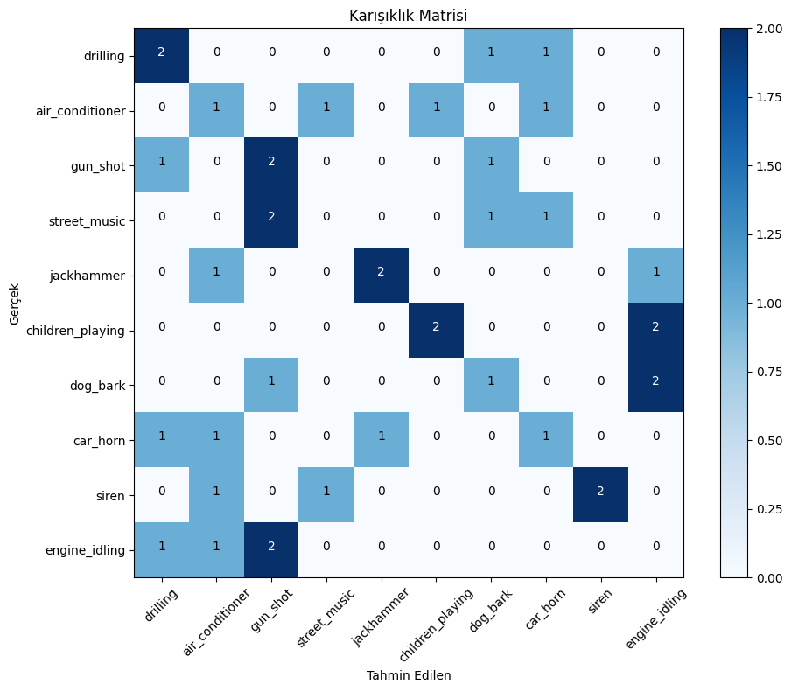
Model 2: Random Forest
Accuracy 32.5%

Slide 18
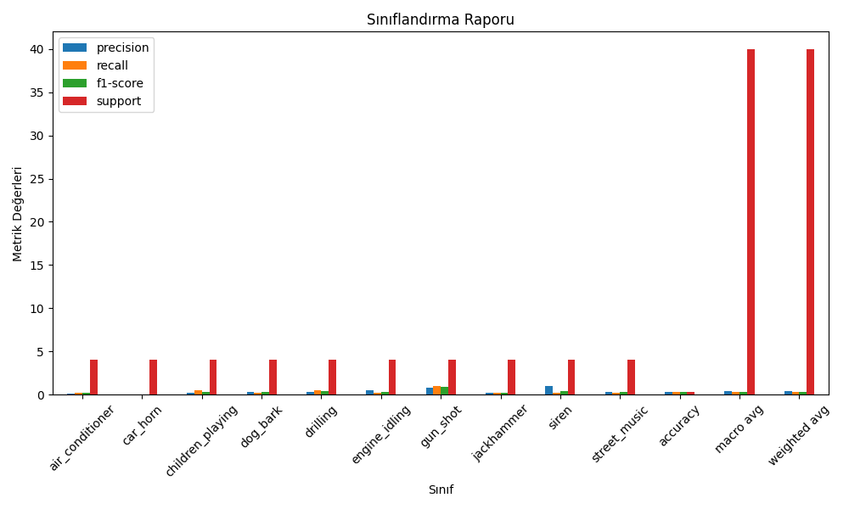
Random Forest
Precision: This measures how accurate the positive predictions are. It tells you how many of the instances the model predicted as positive were actually positive.
Recall: This measures how well the model identifies all the actual positive instances. It tells you how many of the real positive instances the model was able to find.
F1 Score: This is a balance between Precision and Recall. It gives you a single score that takes both into account, making it especially useful when you need to balance the importance of identifying all positives (Recall) and avoiding false positives (Precision).

Slide 19

Libraries Used in the Code
os:
To handle file paths and directories.
librosa:
For audio processing and feature extraction (e.g., MFCC calculation).
numpy (np):
For mathematical and array operations.
pandas (pd):
For reading and manipulating the CSV dataset.
matplotlib.pyplot (plt):
For data visualization (e.g., confusion matrix, feature importance, waveform, MFCC plots).
librosa.display:
To visualize MFCCs and waveforms with librosa.
scikit-learn (sklearn):
train_test_split: For splitting the dataset into training and testing sets.
StandardScaler: For feature normalization.
RandomForestClassifier: Machine learning model for classification.
classification_report and confusion_matrix: For evaluating model performance.
seaborn (sns):
For enhancing data visualizations.
itertools:
To simplify iteration when visualizing the confusion matrix.
random:
To select random test samples for visualization and evaluation.

